Slide 1
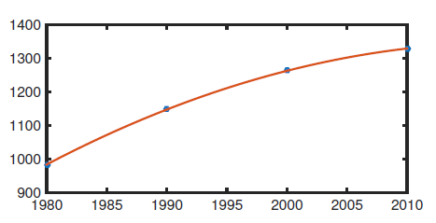
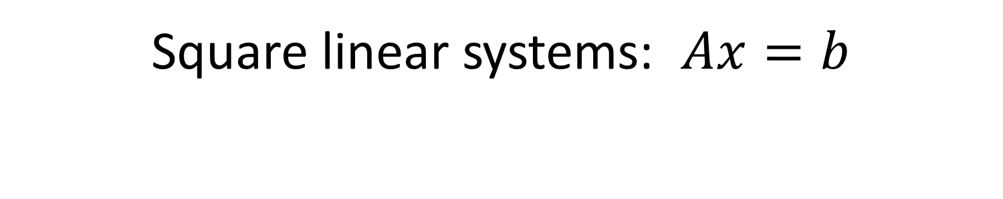
Chapter 2
Square linear systems: $Ax=b$

Slide 2
Square linear systems: objectives
Where these systems may arise
Efficient representation in MATLAB
Learn increasingly sophisticated algorithms to solve these systems
Learn tools to measure the performance of these algorithms
Learn to recognize where difficulties may arise in solving linear systems
Learn to recognize where structure of the problem can be exploited for fast and accurate solutions

Slide 3

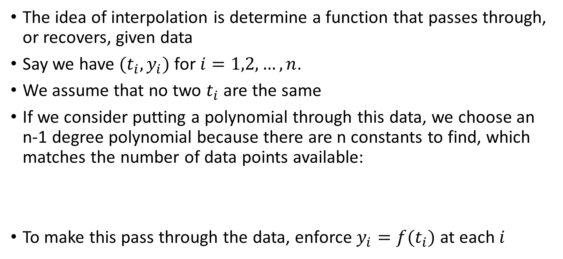
Polynomial interpolation
The idea of interpolation is determine a function that passes through, or recovers, given data
Say we have $(t_{i},y_{i})$for $i=1,2,…,n$.
We assume that no two $t_{i}$ are the same
If we consider putting a polynomial through this data, we choose an n-1 degree polynomial because there are n constants to find, which matches the number of data points available:
To make this pass through the data, enforce $y_{i}=f(t_{i})$ at each $i$

Slide 4
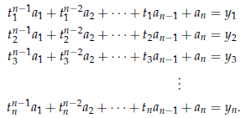
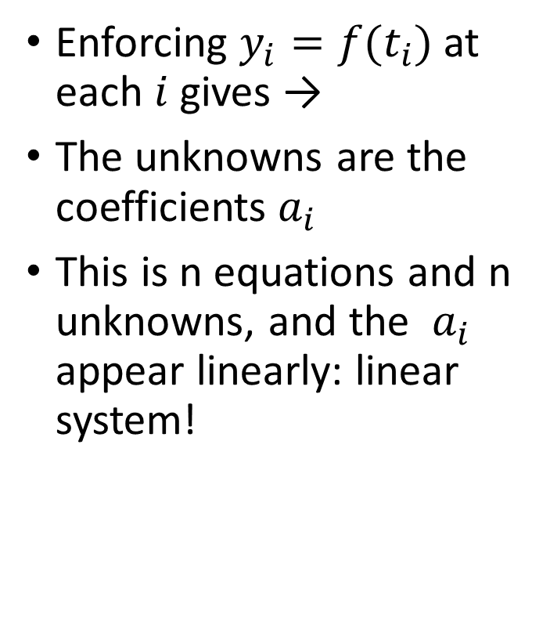
Polynomial interpolation
Enforcing $y_{i}=f(t_{i})$ at each $i$ gives →
The unknowns are the coefficients $a_{i}$
This is n equations and n unknowns, and the $a_{i}$ appear linearly: linear system!

Slide 5
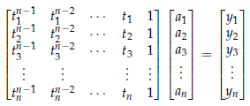
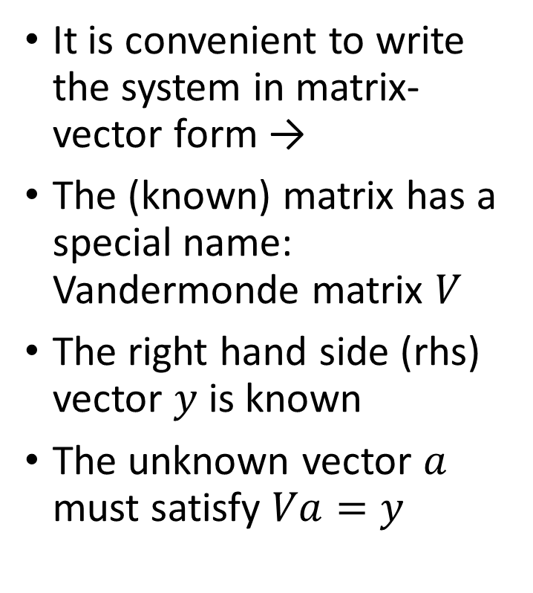
Polynomial interpolation
It is convenient to write the system in matrix-vector form →
The (known) matrix has a special name: Vandermonde matrix $V$
The right hand side (rhs) vector $y$ is known
The unknown vector $a$ must satisfy $Va=y$

Slide 6
An example: Fitting population data
Census data is often measured in 10 year intervals.
How to get population estimates in other years?
May affect policy decisions ranging from social programs like health care to education, business planning, and many other things
We can apply interpolation to available data to compute values in intervening years
Our data is 4 populations for China at 10 year intervals
The idea is to put a cubic polynomial through this data: we have to find the 4 coefficients such that this happens.

Slide 7
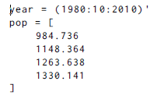
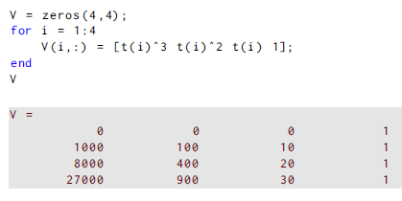
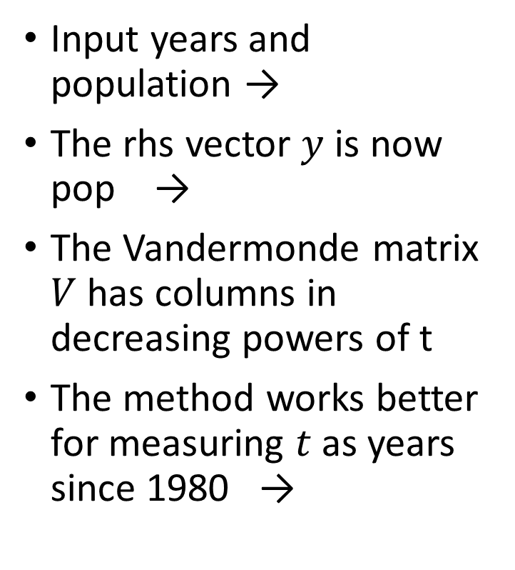
Population example
Input years and population →
The rhs vector $y$ is now pop →
The Vandermonde matrix $V$ has columns in decreasing powers of t
The method works better for measuring $t$ as years since 1980 →

Slide 8


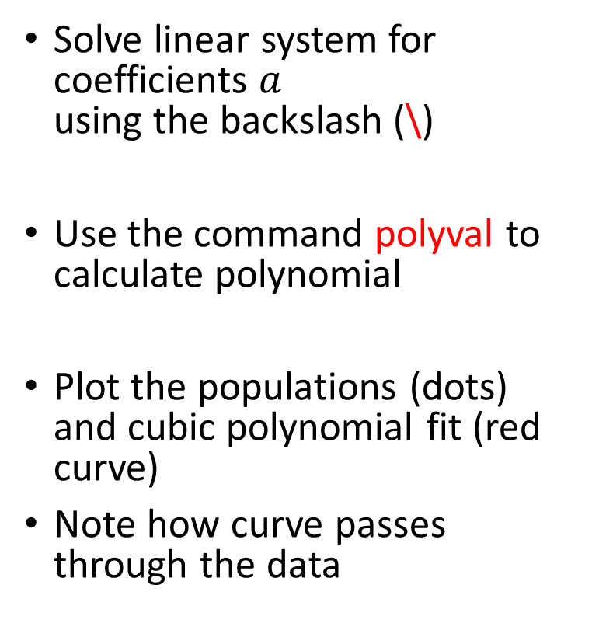
Population example
Solve linear system for coefficients $a$ using the backslash (\)
Use the command polyval to calculate polynomial
Plot the populations (dots) and cubic polynomial fit (red curve)
Note how curve passes through the data

Slide 9
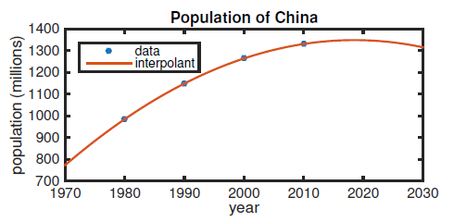
Population example
A better plot with labels
Using the cubic polynomial between the data points is interpolation: solid results
Using the cubic outside the data interval is extrapolation: use with care!!

Slide 10
Computing with matrices in MATLAB
MATLAB originally stood for “Matrix Laboratory”
It is particularly easy to use MATLAB for this kind of computing
Section 2.2 contains a tutorial on creating and manipulating matrices
Try it!

Slide 11
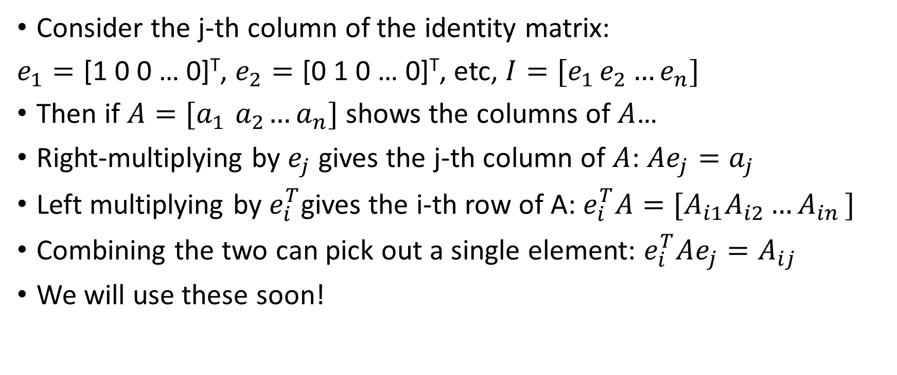
Needed operations for matrices
Consider the j-th column of the identity matrix:
$e_{1}=\text{[1 0 0 … 0]}\text{T}\text{,}$ $e_{2}=\text{[}\text{0 }\text{1 0 … 0]}\text{T}$, etc, $I=[e_{1 }e_{2}…e_{n}]$
Then if $A=[a_{1}{ a}_{2}…a_{n}]$ shows the columns of $A$…
Right-multiplying by $e_{j}$ gives the j-th column of $A$: ${Ae}_{j}=a_{j}$
Left multiplying by $e_{i}^{T}$gives the i-th row of A: $e_{i}^{T}A={[A}_{i1}A_{i2}{…A}_{in}]$
Combining the two can pick out a single element: $e_{i}^{T}Ae_{j}=A_{ij}$
We will use these soon!

Slide 12
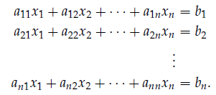
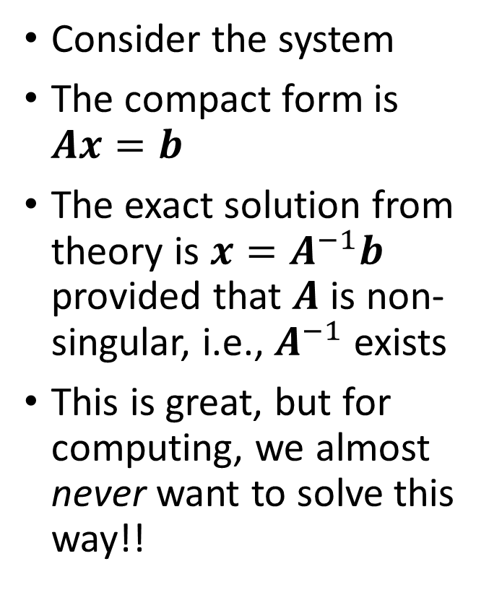
Linear Systems
Consider the system
The compact form is $Ax=b$
The exact solution from theory is $x=A^{−1}b$ provided that $A$ is non-singular, i.e., $A^{−1}$ exists
This is great, but for computing, we almost never want to solve this way!!

Slide 13
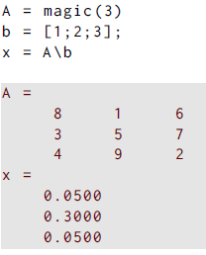
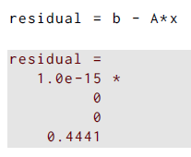
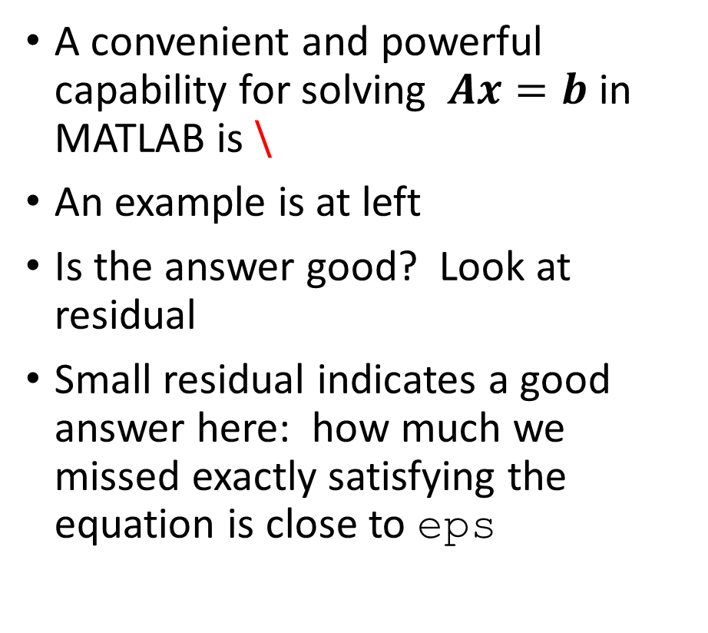
Linear Systems
A convenient and powerful capability for solving $Ax=b$ in MATLAB is \
An example is at left
Is the answer good? Look at residual
Small residual indicates a good answer here: how much we missed exactly satisfying the equation is close to eps

Slide 14
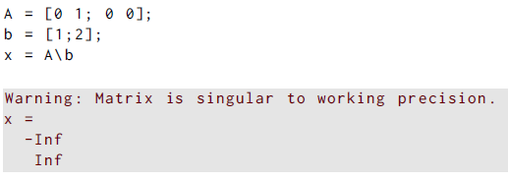
Linear Systems
Care and understanding is still needed though
Note that even for singular A, one still gets an answer from \
We will understand why later
If you see a warning, investigate!!

Slide 15
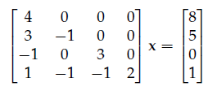
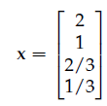
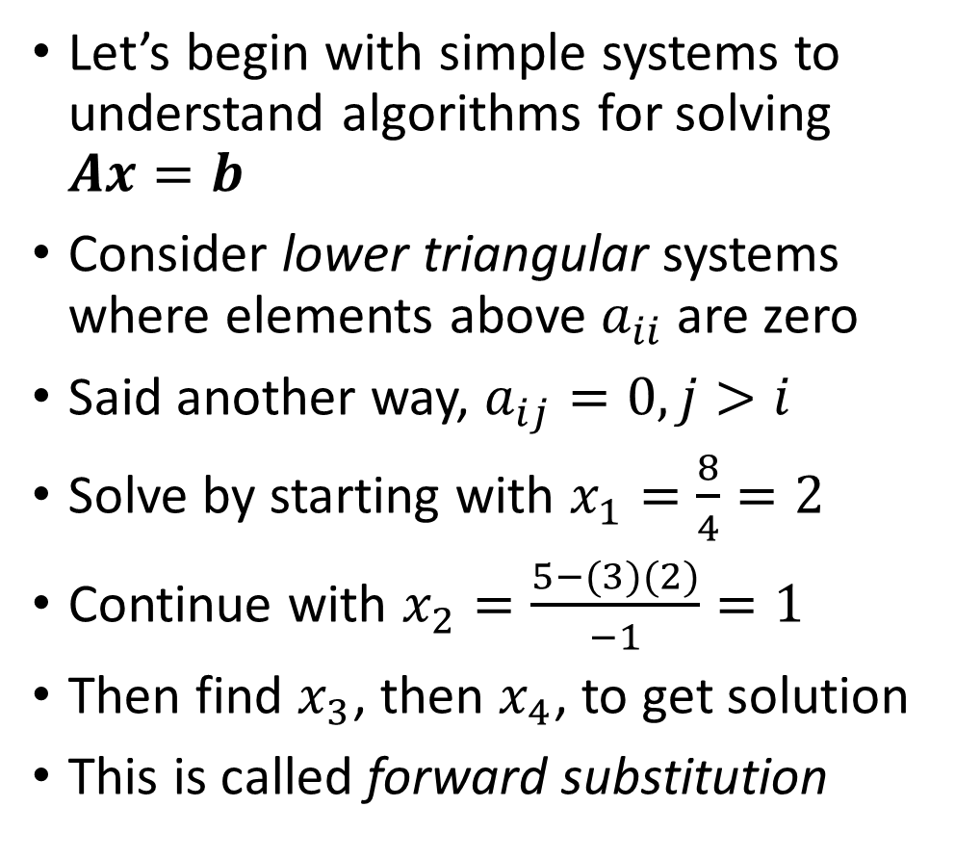
Triangular Systems
Let’s begin with simple systems to understand algorithms for solving $Ax=b$
Consider lower triangular systems where elements above $a_{ii}$ are zero
Said another way, $a_{ij}=0, j>i$
Solve by starting with $x_{1}=\frac{8}{4}=2$
Continue with $x_{2}=\frac{5−(3)(2)}{−1}=1$
Then find $x_{3}$, then $x_{4}$, to get solution
This is called forward substitution

Slide 16
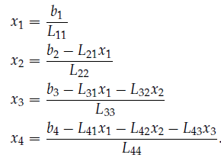
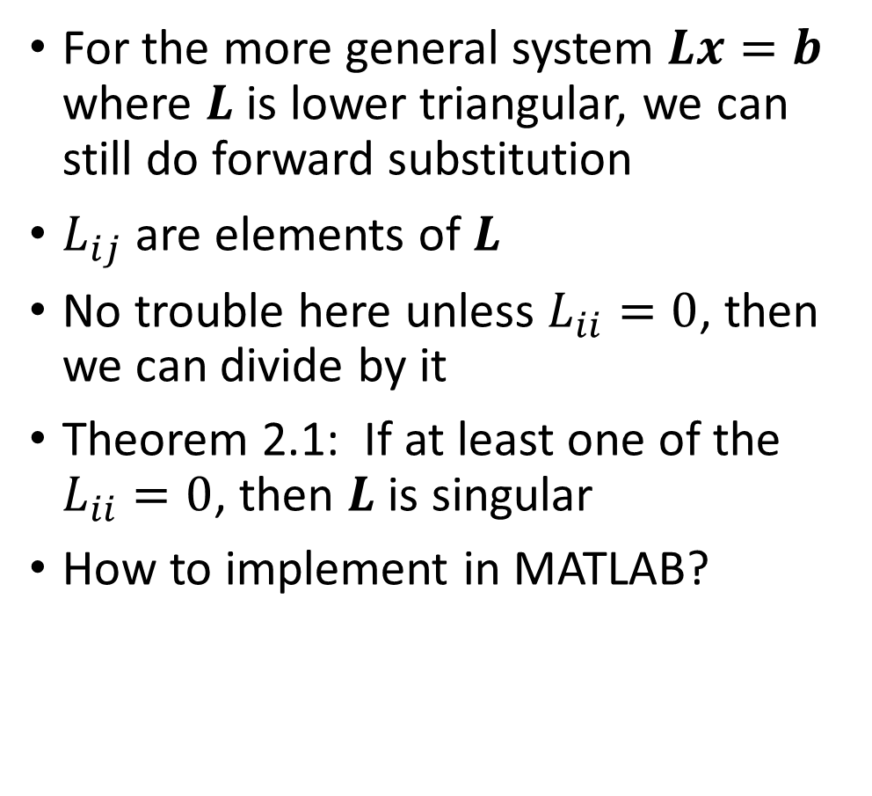
Triangular Systems
For the more general system $Lx=b$ where $L$ is lower triangular, we can still do forward substitution
$L_{ij}$ are elements of $L$
No trouble here unless $L_{ii}=0$, then we can divide by it
Theorem 2.1: If at least one of the $L_{ii}=0$, then $L$ is singular
How to implement in MATLAB?

Slide 17
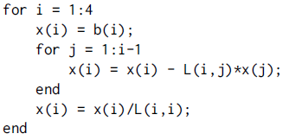
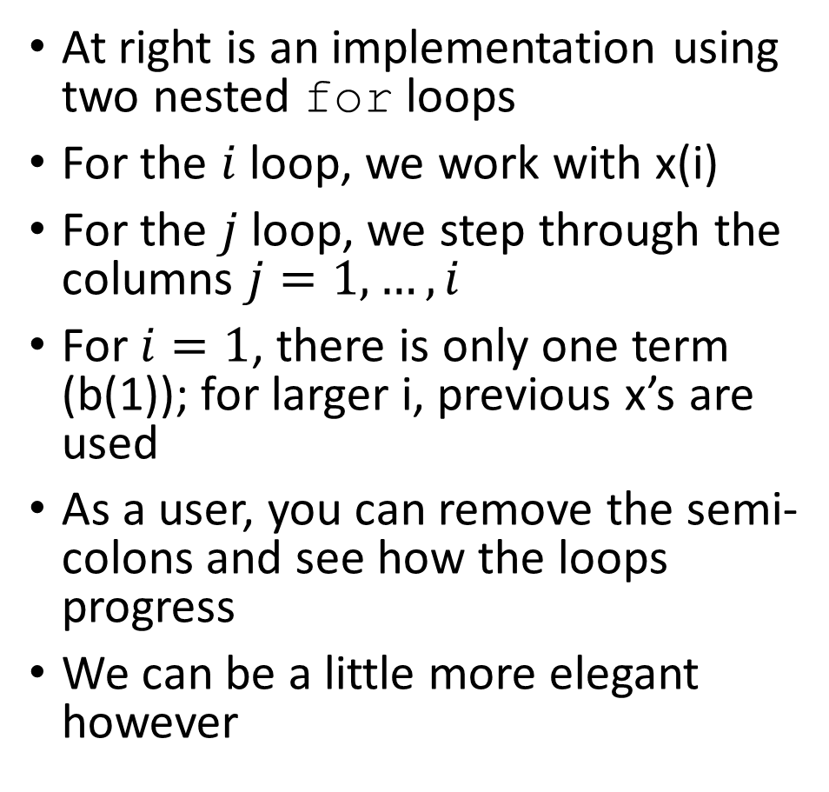
Triangular Systems
At right is an implementation using two nested for loops
For the $i$ loop, we work with x(i)
For the $j$ loop, we step through the columns $j=1,…,i$
For $i=1$, there is only one term (b(1)); for larger i, previous x’s are used
As a user, you can remove the semi-colons and see how the loops progress
We can be a little more elegant however

Slide 18


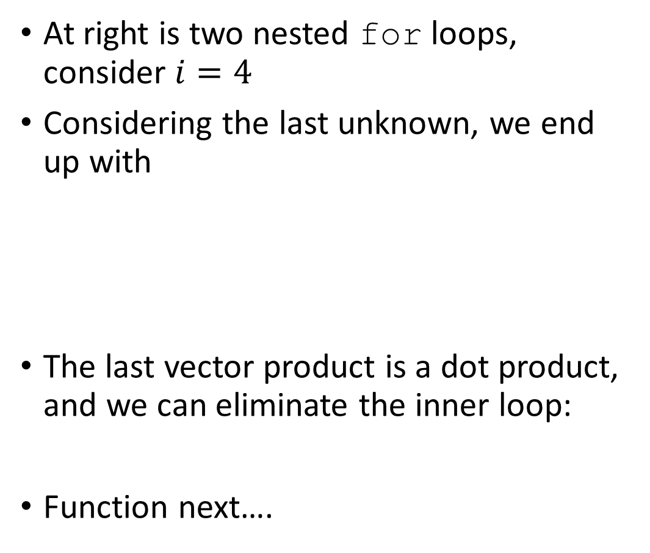
Triangular Systems
At right is two nested for loops, consider $i=4$
Considering the last unknown, we end up with
The last vector product is a dot product, and we can eliminate the inner loop:
Function next….

Slide 19
Lower Triangular Systems
At right is two nested for loops, consider $i=4$
Considering the last unknown, we end up with
The last vector product is a dot product, and we can eliminate the inner loop:
Function next….

Slide 20
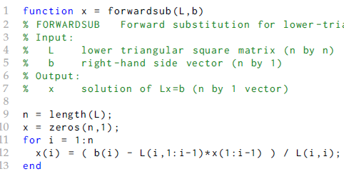
Lower Triangular Systems
Pass in L and b; return solution x
Note comments; they appear in help forwardsub
Detect system size n automatically
Single loop implementation
No test for singular L

Slide 21
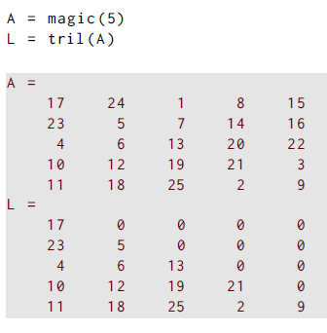
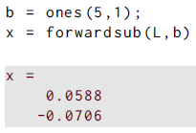

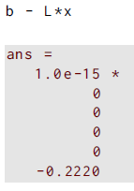
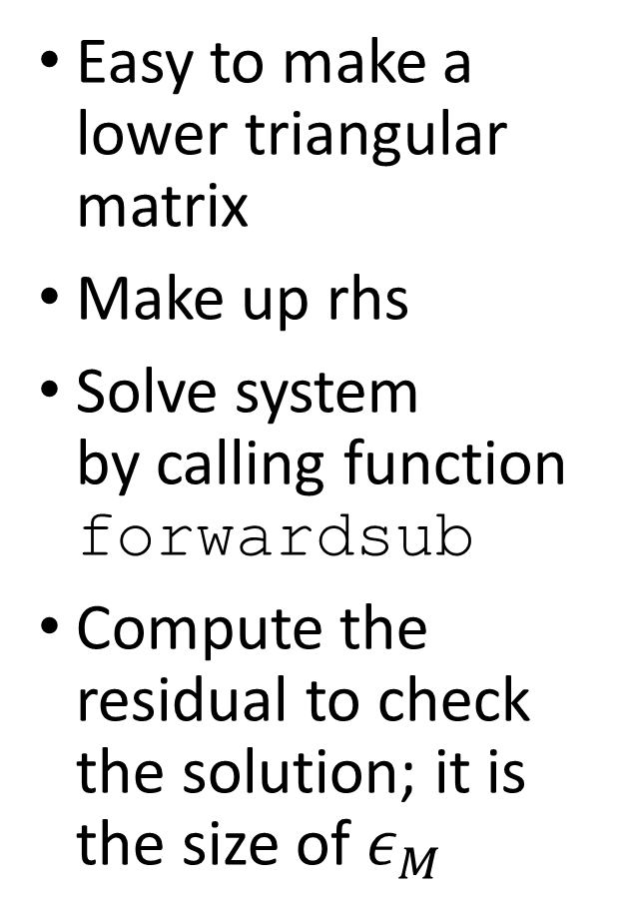
Lower Triangular Example
Easy to make a lower triangular matrix
Make up rhs
Solve system by calling function forwardsub
Compute the residual to check the solution; it is the size of $ε_{M}$

Slide 22
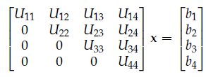
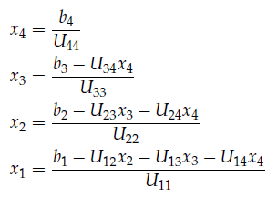
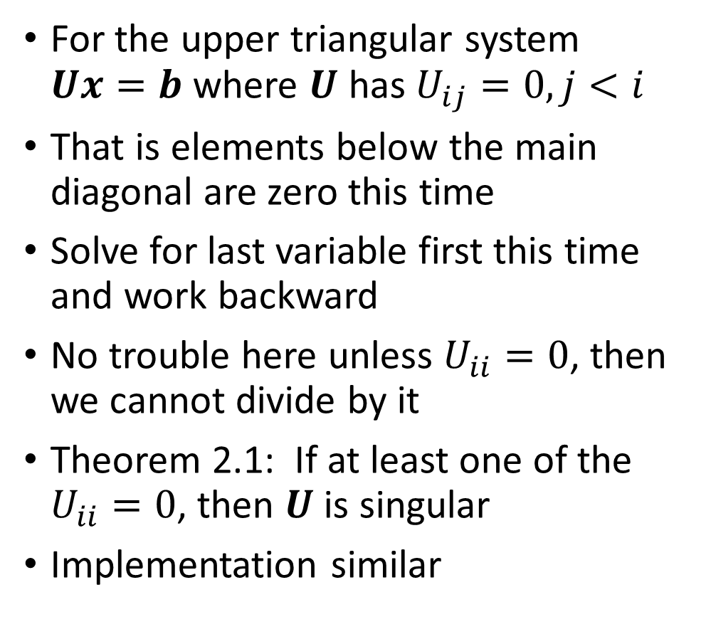
Upper Triangular Systems
For the upper triangular system $Ux=b$ where $U$ has $U_{ij}=0, j<i$
That is elements below the main diagonal are zero this time
Solve for last variable first this time and work backward
No trouble here unless $U_{ii}=0$, then we cannot divide by it
Theorem 2.1: If at least one of the $U_{ii}=0$, then $U$ is singular
Implementation similar

Slide 23
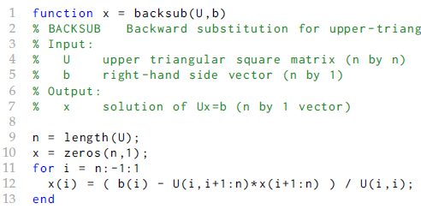
Upper Triangular Systems
Pass in U and b; return solution x
Note comments; they appear in help backsub
Detect system size n automatically
Single loop counts down now
No test for singular U

Slide 24
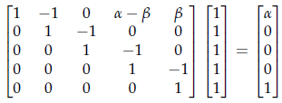
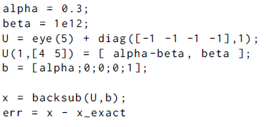
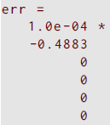
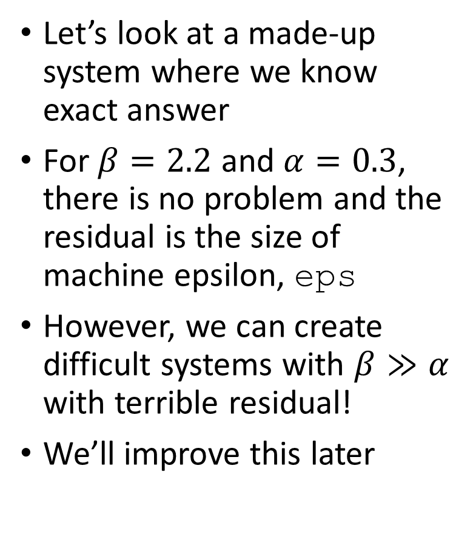
Triangular Systems
Let’s look at a made-up system where we know exact answer
For $β=2.2$ and $α=0.3$, there is no problem and the residual is the size of machine epsilon, eps
However, we can create difficult systems with $β≫α$ with terrible residual!
We’ll improve this later

Slide 25
Gaussian elimination and LU factorization
A general purpose algorithm for solving linear systems is Gaussian elimination (GE)
We will use this algorithm to adapt it so that it yields an LU facutorization; this is just our first example of factorization
We will further adapt the method to improve its stability and robustness a bit later
You should have seen the basic GE method prior to this class
We incorporate MATLAB in discussing the method here

Slide 26
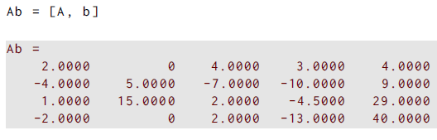
GE example
First, create a 4x4 linear system
Then, we append the right hand side to the coefficient matrix to obtain the augmented matrix
GE is then performed on this augmented matrix

Slide 27
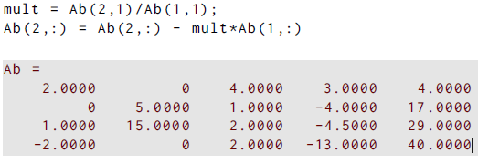
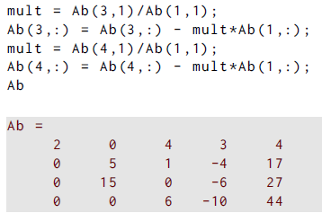
GE example
We now want to make Ab(2:4,1)=0
That is, elements below row 1 (R1) become zero in first column
Compute multiplier mult, then do R2 <- R2- mult*R1
Repeat this process for R3 and R4, recomputing mult for each row

Slide 28
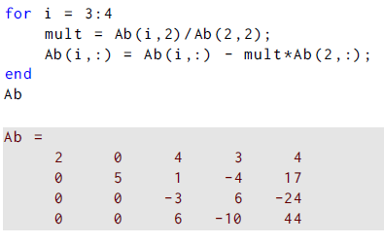
GE example
We now want to make Ab(3:4,2)=0
That is, elements below R2 become zero in 2nd column
Compute multipliers mult, for R3 and R4, recomputing mult for each row, in a loop

Slide 29
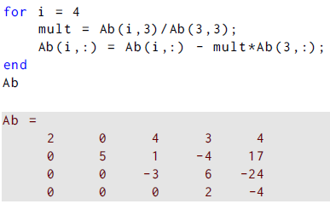

GE example
We now want to make Ab(4:4,3)=0
That is, repeat the process for column 3, below R3
This time loop only runs once, but can still be loop structure
The first four columns are a 4x4 upper triangular matrix U, and the last column is a rhs z so that Ux=z
Now use back substitution!

Slide 30
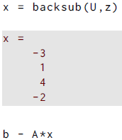
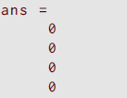
GE example
Solve for x with back substitution
Error is quite small!
This is a general strategy to solve systems
How can we use this to get a factorization? And why?

Slide 31
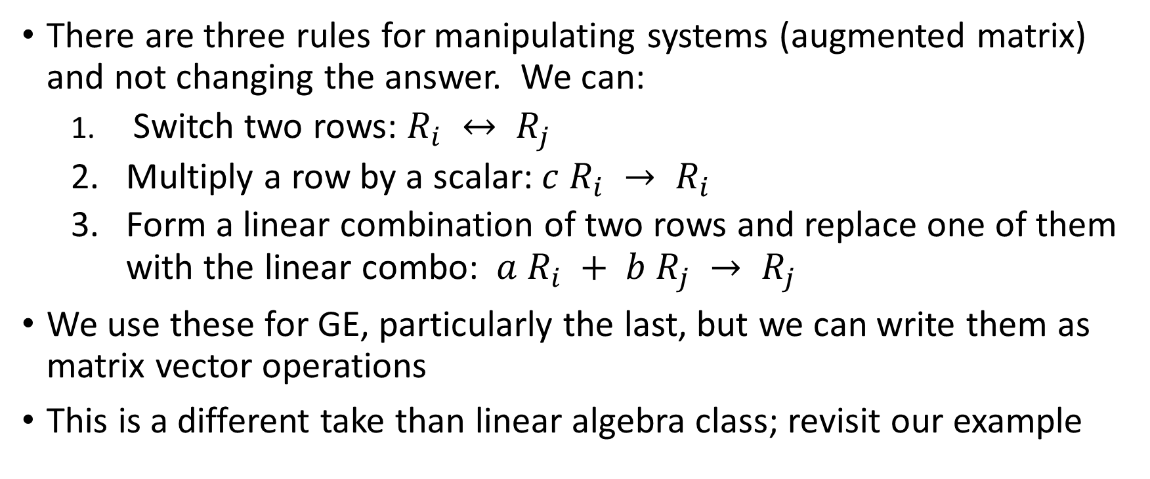
GE or algebra rules
There are three rules for manipulating systems (augmented matrix) and not changing the answer. We can:
Switch two rows: $R_{i} ↔ R_{j}$
Multiply a row by a scalar: $c R_{i} → R_{i}$
Form a linear combination of two rows and replace one of them with the linear combo: $a R_{i} + b R_{j} → R_{j}$
We use these for GE, particularly the last, but we can write them as matrix vector operations
This is a different take than linear algebra class; revisit our example

Slide 32
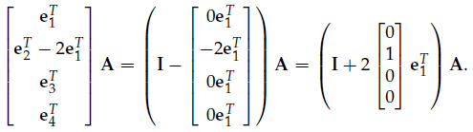
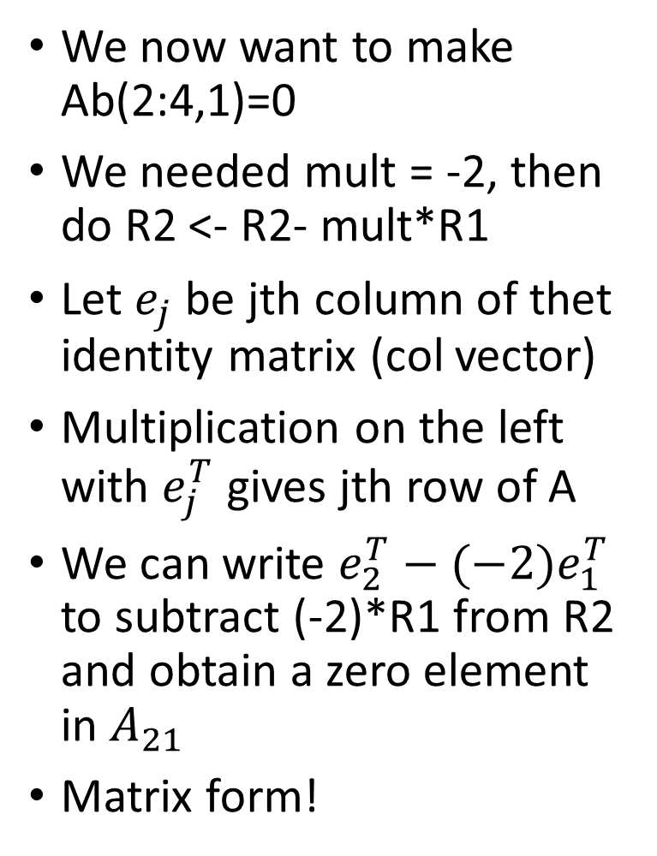
GE matrix ops
We now want to make Ab(2:4,1)=0
We needed mult = -2, then do R2 <- R2- mult*R1
Let $e_{j}$ be jth column of thet identity matrix (col vector)
Multiplication on the left with $e_{j}^{T}$ gives jth row of A
We can write $e_{2}^{T}−(−2)e_{1}^{T}$ to subtract (-2)*R1 from R2 and obtain a zero element in $A_{21}$
Matrix form!

Slide 33



GE matrix ops
Use matrix ops to make Ab(2:4,1)=0
Elements below row 1 (R1) become zero in first column again
Compute multiplier mult, then do R2 <- R2- mult*R1
Repeat this process for R3 and R4, recomputing mult for each row

Slide 34

Elementary Matrices for GE
To change the $A_{21}$element, we used
Call that matrix $L_{21}$
To change $A_{31}$, use $L_{31}=I−0.5e_{1}^{T}e_{3}$
To change $A_{41}$, use $L_{41}=I−(−1)e_{1}^{T}e_{4}$
So, to change the first column under $A_{11}$ , we can write steps in the matrix form: $A_{1}=L_{41}L_{31}L_{21}A$
We can also write $L_{j1}=I−m_{j1}e_{j}e_{1}^{T}$ and we had three different multipliers

Slide 35

Elementary Matrices, toward LU
To change the second column, we use $L_{42}L_{32}$, with the right one done first, and multipliers $m_{42}$ and $m_{32}$
The cumulative operations are then $A_{1}=L_{42}L_{32}L_{41}L_{31}L_{21}A$
To change $A_{43}$, use $L_{43}=I−m_{43}{e_{4}e}_{3}^{T}$
So, combining all of these gives us the upper triangular form we sought: $U=L_{43}L_{42}L_{32}L_{41}L_{31}L_{21}A$
Note that applying these to the right side b will give $z$ for $Ux=z$
We get something useful for recovering $A$...

Slide 36



Elementary Matrices, toward LU
These elementary matrices $L_{ij}$ and their inverses have remarkably useful properties
Multiply two that differ only in sign together:
This says that the two matrices on the left are inverses! So,
and think of α as a multiplier $m_{ij}$
We then have $L_{ij}^{−1}=I+m_{ij}{e_{i}e}_{j}^{T}$, and we know all those inverses!

Slide 37
Elementary Matrices, toward LU
We also need to know about the produce of all of them
Multiply two general elementary matrices together:
Second term puts α in (2,1) location and β in (3,2) location
Last term?

Slide 38

LU factorization
The product of the inverses is then of the form
$$L=L_{21}^{−1}L_{31}^{−1}L_{32}^{−1}=\left[\begin{matrix}1 & 0 & 0 \\ m_{21} & 1 & 0 \\ m_{31} & m_{32} & 1\end{matrix}\right]$$
Those multipliers that we used to create zero in the columns can go right into the lower triangular matrix $L$!
And, finally, we have
$$LU=A$$
This shows that A can factored or factorized into a lower triangular $L$ and upper triangular $U$
Just our first instance of factorization…

Slide 39

Using LU factorization
We can rewrite the system $Ax=b$ as $LUx=b$
Substitute to get $LUx=b$;
then let $Ux=z$;
Then $Lz=b$
This suggests how to use LU:
Compute the factorization $LU=A$ using Gaussian elimination
Solve $Lz=b$ using forward substitution
Solve $Ux=z$ using backward substitution
For same $A$, repeat 2 and 3 for different $b$ without step 1

Slide 40

Function for LU

Slide 41



LU example: compute factors
Lufact computes L and U
Checking the product: looks like A
Error shows that it works

Slide 42


LU example: solve a system
Lufact computes $L$ and $U$
Forward solve to get $z$
Backward solve for $x$

Slide 43
Performance of Linear System Solutions
Sections 2.5 and later are in Part 2

